Slide 1

Global Directory
Prepared by:
Saurav Gupta

Slide 2
Objective
  An System to capture personal information of an Individual.
  System which can be used for Data Analysis or by Census.
  Secured data storage
  Secured Mechanism of contacting your friends and to send messages.

Slide 3
Overview
Global Directory
  An online Directory of personal information – personal details, family details and etc.
  Accessible by any community of users but requires login and Password.
  Can contact any other Member via secured Mechanism.
  All information is stored in cryptic.
  Information captured is divided into two domains –
      Private Domain
      Public Domain

Slide 4
PINs / Domains
We would be generating two unique PINs for each member.
K-PIN (Key Personal Identification Number)
  Generated based on key information – Public Domain
  Key information is not updatable.
  Name, DOB etc...
V-PIN (Variable PIN)
  Generated based on variable information – Private Domain
  This information is updatable.
  Contact Details, Property Details etc...
Auto-generated KPIN on Sign-up

Slide 5
Scope Exclusion and Inclusion
Scope Inclusion
  Analyze the algorithms to store information in cryptic and compressed form in Database.
  Create forms to collect data.
  Provide Secured Mechanism to contact your friends
Scope Exclusion
  Implementation of algorithm to store data in compressed form.
  Data Analysis.

Slide 6
Project Phases
To meet the project objectives within the given time frame, the project is implemented in the following phases:
Study and Acquire Knowledge | Analyzing Algorithms | System Designing | Implementation
Define Scope of Project Environment setup Study of different existing Compression and Encoding Techniques Learning Technologies – ASP.NET 2.0 and SQL Server 2005 | Compare different algorithms Come-up with the appropriate algorithm for Compressed data storage | Design Database Architecture Design Layout of Pages | Create forms to collect data Implement the Algorithm.

Slide 7
System Architecture
A client-server application is a distributed system comprising both client and server software.
A client software process initiates a communication session, while the server waits for requests from any client.
A Web Browser is a client program at the user computer that may access information at any web server in the world.
A Web Server is a computer program that is responsible for accepting HTTP requests from Web, and serving them HTTP responses along with optional data contents.
Since data storage is centralized, updates to that data are easier to administer.
Client Server –
Web Browser
Request for page
Web Server
Request for data
Database
HTML Page with required contents
Received Data
Client-Server Model

Slide 8
Security
PINs
  All information is stored in cryptic format
Login
  Information accessible to users having Login and Password.
Shared Information is bounded by Public Domain

Slide 9
Encoding and Compression
As all information is stored in terms of PINs, so encoding also involves compression.
Resulting in occupying less data space
KPIN/VPIN
Information
Compression
Encoding
Decompression
Decoding
Information

Slide 10
Secure Communications
Allows Exchange of information via emails
Emails can be sent to a Group or an individual
Group Emails:
  Requires Approval of Email to avoid malicious emails
  Based on selected search criteria
Email to an Individual:
  No Approval required.
  But Email Id will not be shared and other member can reply via the Directory.
  Thus exchange of information without knowing the Email ID of each other, so no sharing of Personal information.

Slide 11
Salient Features
Requires less data storage space
Provides High data security
Scalable
Available Online
Easy to use

Slide 12
Information Captured
Family Details
Contact Details
Offspring Details
Sibling Details
Birth/Deaths in Family
Others Details
  Educational Details
  Professional Details
  Property Details

Slide 13
Technical Architecture
MVC Mechanism
  Model View Controller Technical Architecture is followed while designing of Web pages.
Model
  Refers to Data Modeling – Data Access Layer
View
  Refers to GUI – User Interface Layer
Controller
  Refers to Controlling view – Business Layer

Slide 14
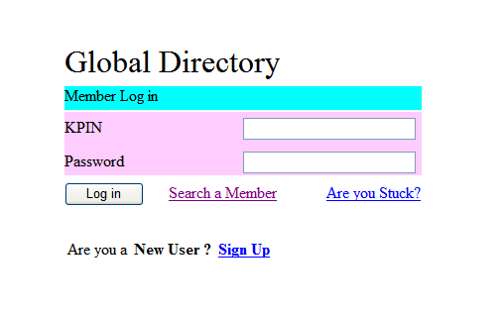
Login Screen

Slide 15
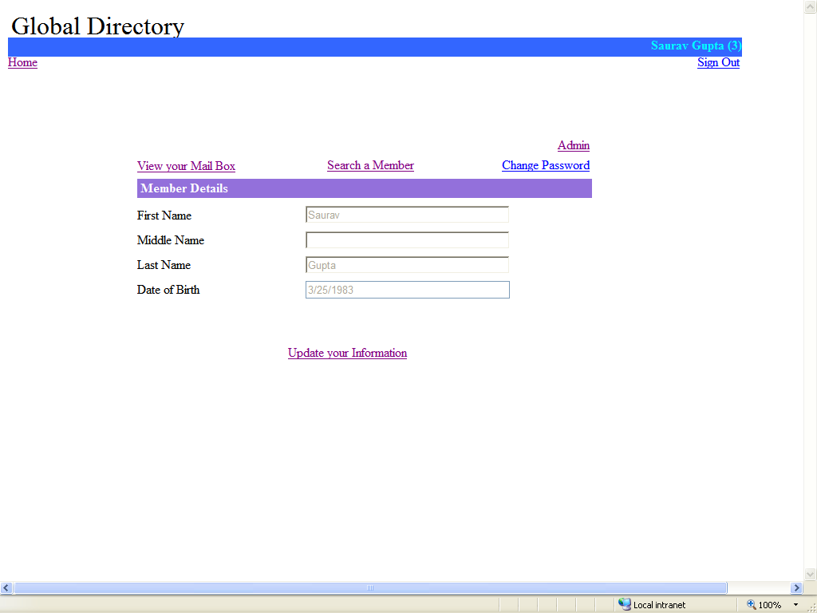
Home Page

Slide 16
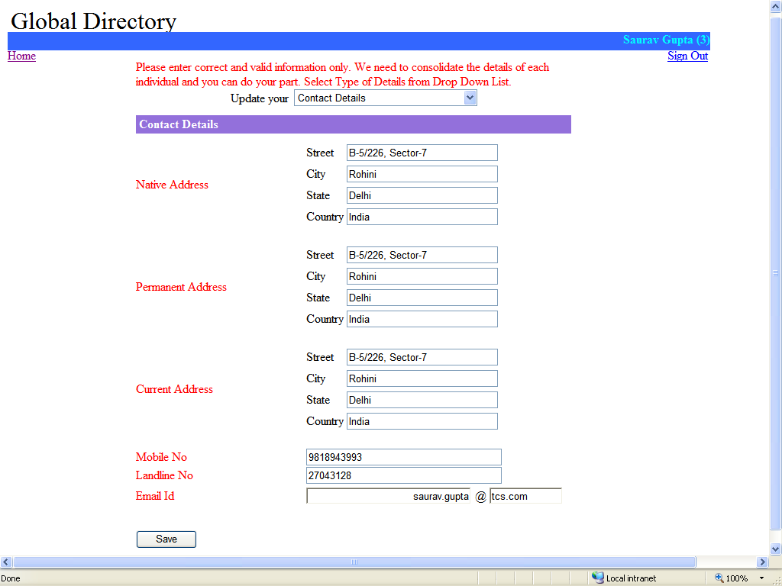
Contact Details

Slide 17
Technology Stack
S/W Requirement
  SQL Server
  MS Visual Studio 2005
  .NET Framework 2.0
  IIS
H/W Requirement
  Windows XP
  1 GB RAM
Client – Internet Browser
Server – Can be placed anywhere

Slide 18
Questions ?

Slide 19
Thank You!!!

